Slide 1
Deco: Declarative Crowdsourcing
Notes:
Hello everyone, today I’m talking about a paper that discussed Deco,
database system for declarative crowdsourcing
Declarative System - where the end user describes the needs, and the system dynamically figures out what and how to obtain crowd data, and how it must be integrated with other data.

Slide 2
Challenges
Notes:
Naturally there were several challenges
Resolve disagreeing human opinions
Determining how the database system interacts with the human workers
Choosing the right data model and query language
What data should it store? Clean data or raw data? What does it show to the user?

Slide 3
Designed to be:
General
Flexible
Principled
Notes:
The system the researchers designed is made to be
general to allow the use of other models
flexible for custom data cleansing and external access
principles such that it has precisely defined semantics

Slide 4
Paper focuses on:
Data model
Query language
Prototype
Notes:
The paper focuses on three main parts
THe data model
The Query Language
And the implementation of a prototype.
Throughout the paper they use the example of the restaurant and it’s name, address, rating and cuisine. They also have a separate logical relation for the address for address, city and zip.

Slide 5
Data Model
Notes:
The first section, the data model. This covers three parts

Slide 6
Conceptual schema
Raw schema
Data model semantics
Notes:
As I mentioned earlier, the models of the Restaurant and the address are part of the conceptual schema
But in addition we have
anchor attributes and dependent attribute types
And this is the diagram they had, which I will go into further detail soon

Slide 7
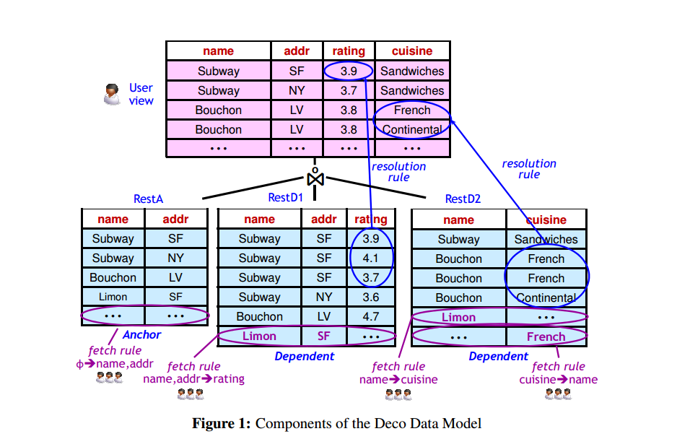
Notes:
Here we have what the user sees, and the underlying tables that make up their view.
Let me explain what are looking at here
The user specifies which attributes are anchors and which are dependent.
There is one anchor tables (rest A) containing the anchor attributes
One dependent table for each dependent attribute (in this case rating and cuisine)
The system is based on the idea of Fetch-REsolve-Join.
First we fetch data using fetch rules
Then we resolve inconsistencies using resolution rules
Then we join the raw tables to produce conceptual relations.
The part of the conceptual schema that I’ll talk about first are the

Slide 8
1. Resolution Rules
[RR1, relation Restuarant] name, address -> rating: avg()
Notes:
Resolution rules
These determine how to handle inconsistent or uncertain values obtained from the crowd
In the paper they define a resolution function that takes a set of input that would clean the data that is input into it.
Here is an example of a resolution rules, where it would average the ratings if there are several entries. In other cases, we might want to eliminate duplicates, or take the majority.
There are five such rules, which I will list
THe rating for a restaurant is the average of the rating in the raw data
The cuisines for each restaurant are listed with duplicates removed
The name-address pairs are put in a standard form, so that entity resolution is each
If there are multiple zip codes, the one used most often is the one that will be used for the restaurant
If the address is uncertain or inconsistent a simple identity solution function is performed

Slide 9
Notes:
For example,

Slide 10
2. Fetch Rules
[FR1] R.name, R.address -> R.rating: P1
Notes:
A designed may specify as many fetch rules as they want. They are pretty much access methods.
These fetch rules can be tied to a Mechanical Turk Task for example.
And they dictate such things as what information is used to source what information.

Slide 12
Conceptual schema
Raw schema
Data model semantics
Notes:
Moving onto the raw schema for the tables, we have a one anchor table whose attributes are the anchor attributes of whatever relation we defined in our conceptual schema
And one dependent table for each dependent attribute-group.

Slide 13
Fetch
Resolve
Join
(and metadata)
Notes:
Moving onto the semantics of the data model, we have three main parts: fetch, resolve, and join.
Fetch invokes fetch rules to gather and insert raw data
Resolve then invokes resolution rules on these raw tables
THe final step join, then joins in the newly acquired data into what we had previously.
In order to deal with the messy aspect of crowdsourcing, they proposed having metadata columns in the raw data. Examples of useful meta data might be data expiration dates, worker quality, confidence scores, and which fetch rules fetched what data.

Slide 14
Query Language
Notes:
Onto the query language! For the most part, it resembles SQL

Slide 15
Select name, address From Restaurant Where cuisine = ‘Thai’ and rating > 4
Notes:
Here is an example query. Sometimes however, the query could be empty, even if correctly, so there are additions made.

Slide 16
AtLeast n
MaxTime
MaxBudget
MaxFetches
Notes:
For example, we can specify such things such as AtLeast5, so that our query processor will collect additional data until it gets 5 highly rated Thai restaurants. There is also a bunch of things we can do here.

Slide 17
Processing Queries
Incremental Push
Async Pull
Two Phase
Notes:
At the execution level, we have some interesting problems.
Our data may change,
we could end up with too much data,
and our data pay have high latency.
For this we have a Push-Pull Hybrid model with the following features..
We have incremental push as the result of a fetch rule is handles as an update to one or more of the raw tables and propagated to the user view.
We attempt multiple fetches and parallel
fetches and feed the information as it comes in
And we have a two phase system. FIrst we try to answer with our current data, and if that’s not sufficient, we query for more.

Slide 18
Query Plans
Basic Plan
Predicate Placement
Reverse Fetches
Combined Fetches
Notes:
There are several ways we can go from query to fetches, which are visualized on the next slide.

Slide 19
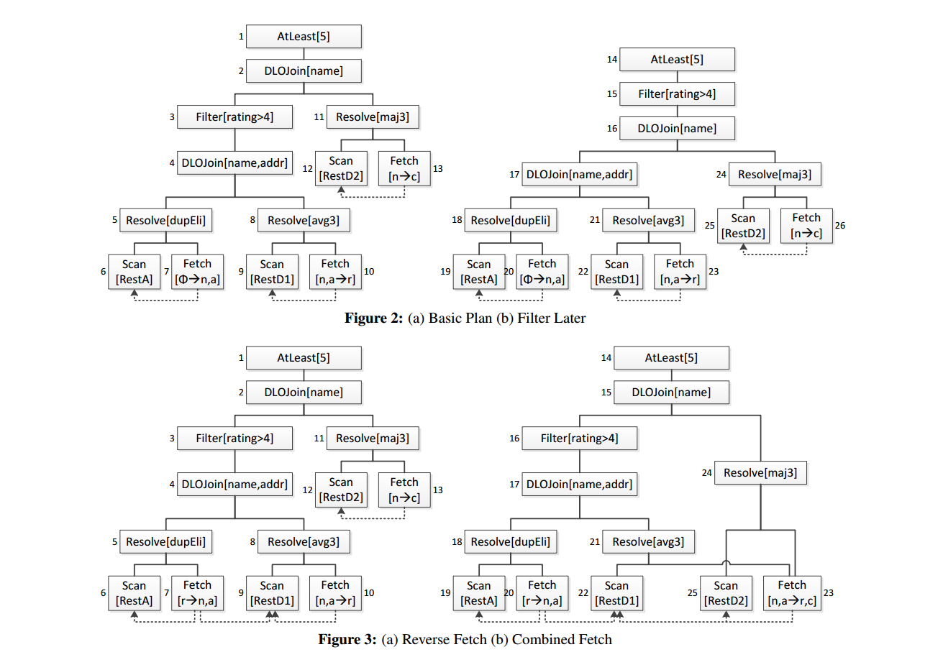
Notes:
Basic, fetch, then filter
In the filter later, the filter is placed higher. Thus, it will fetch cuisine only for the restaurants that satisfy the rating >4
In the reverse fetching, first we fetch by rating, and then see if it the cuisine we want.
Combined fetches, we have a fetch rules that gather multiple dependent attributes at the same time.

Slide 20
Prototype

Slide 21
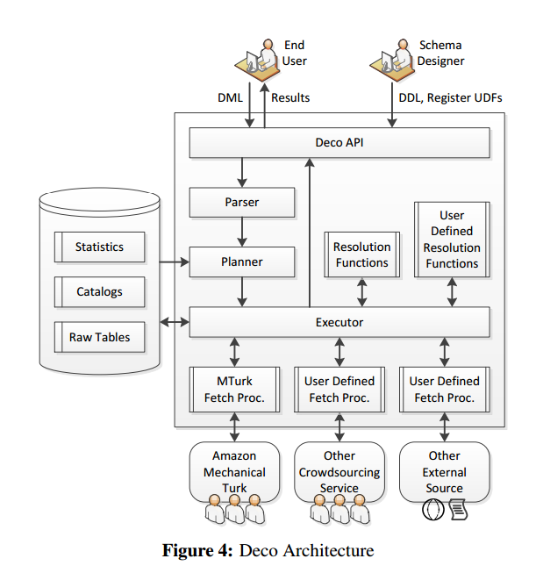
Notes:
Have any of you built a crowdsourcing system before?
The prototype was implemented a python with sqlite backend, and a Deco api. On top, they built a command line interface, a web based gui, that executes queries, visualized the information and shows log messages
The conducted several experiments on their system at a price of five cents per fetch rule invocation.

Slide 22
Notes:
First they tested the performance for different fetch configurations
Results being non_Null result tuples
We note that fetch rules that get multiple pieces of information at once and those that operate in the reverse direction offer significant benefits over basic fetch rules
Fairly clean data

Slide 24
Notes:
Then different query plans
Notes
The predicate pull down transformation makes Deco query plans invoke fetch rules more often in parallel, which brings down latency.

Slide 25
Comparison to
CrowdDB
Notes:
Did you guys note any key differences?
They called out the key differences
Unlike CrowdDB, Deco gives the schema designed the flexibility to design their own fetch rules
Deco stores the raw data and then chooses how to display it
Deco makes fewer assump[tion about eh schema (no primary keys)
Deco has more precisely defined semantics)

Slide 26
Summary of
contributions
Notes:
A datamodel that is practical and derived from the familiar relational data model.
A query language that minimally departs from SQL.
Design for the query processor.
Experimental analysis of queries and comparison.
Interesting that cost was fixed.

Slide 27
Thank you!

